Slide 1
IML
Session 1: Understanding the basics of Machine Learning and CRISP DM framework

Slide 2
What is AI?
AI is intelligence demonstrated by machines
AI is also called as Machine Intelligence

Slide 3
What is Machine Learning?
“Machine learning is based on algorithms that can learn from data without relying on rules-based programming.”- McKinsey & Co.
“Machine learning algorithms can figure out how to perform important tasks by generalizing from examples.” – University of Washington

Slide 4
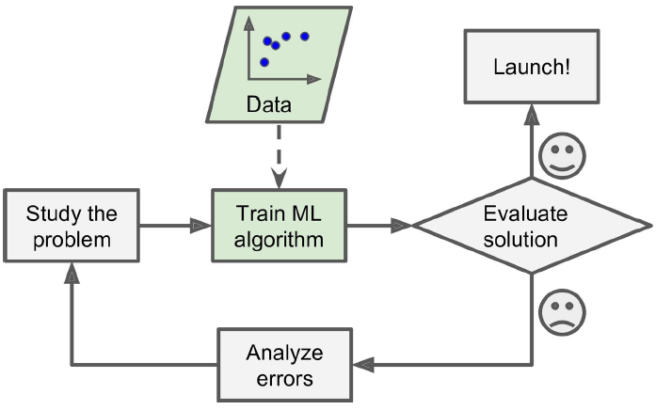
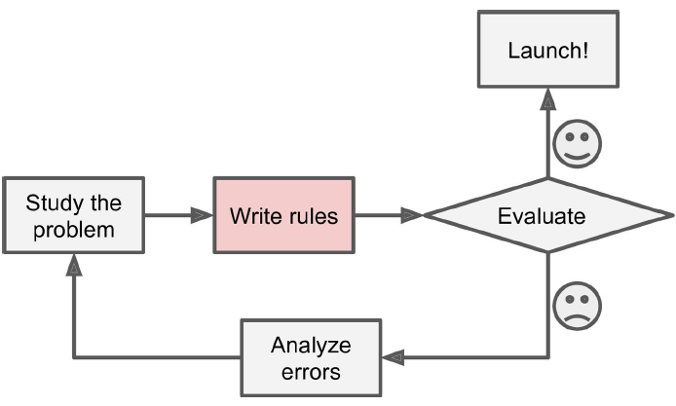
Traditional Programming -Vs- ML approach
Explicitly programmed
Learn from data
Source: Aurélien Géron, Hands-On Machine Learning with Scikit-Learn and TensorFlow, O’Reilly Media, 2017

Slide 5
Data Mining
Data mining uses two components (database and machine learning) for data management and data analysis techniques
It helps extract valuable data that can provide excellent insights into a product or service
https://www.kdnuggets.com/2022/06/data-mining-different-machine-learning.html

Slide 6
Process Models for Data Mining
CRISP-DM
ASUM-DM
SEMMA
CASP-DM
KDD (Knowledge Discovery in Databases)
RAMSYS (RApid collaborative data Mining SYStem)
Foundational Methodology for Data Science (FMDS)
Team Data Science Process (TDSP)

Slide 7

CRISP-DM
CRoss-Industry Standard Process for Data Mining

Slide 8
Business Understanding
Determine business objectives
Assess situation
Determine data mining goals
Produce project plan

Slide 9
Data Understanding
Collect initial data
Describe data
Explore data
Verify data quality

Slide 10
Data Preparation
Select data
Clean data
Construct data
Integrate data
Format data

Slide 11
Modeling
Select modeling technique
Generate test design
Build model
Assess model

Slide 12
Model Evaluation
Evaluate model
Review results
Determine next steps

Slide 13
Deployment
Plan deployment
Plan monitoring and maintenance
Produce final report
Review project
Model Management (Refreshes)

